Slide 1
The Evolution of the Stellar Mass-Chemical Abundance Relation over Seven Billion Years
Caroline McCormick
Major: Astronomy, Minor: Physics, Math, Computer Science
Faculty Advisor: Dr. Chun Ly; Steward Observatory, University Libraries
Arizona/NASA Space Grant Research Symposium | April 18, 2020

Slide 2
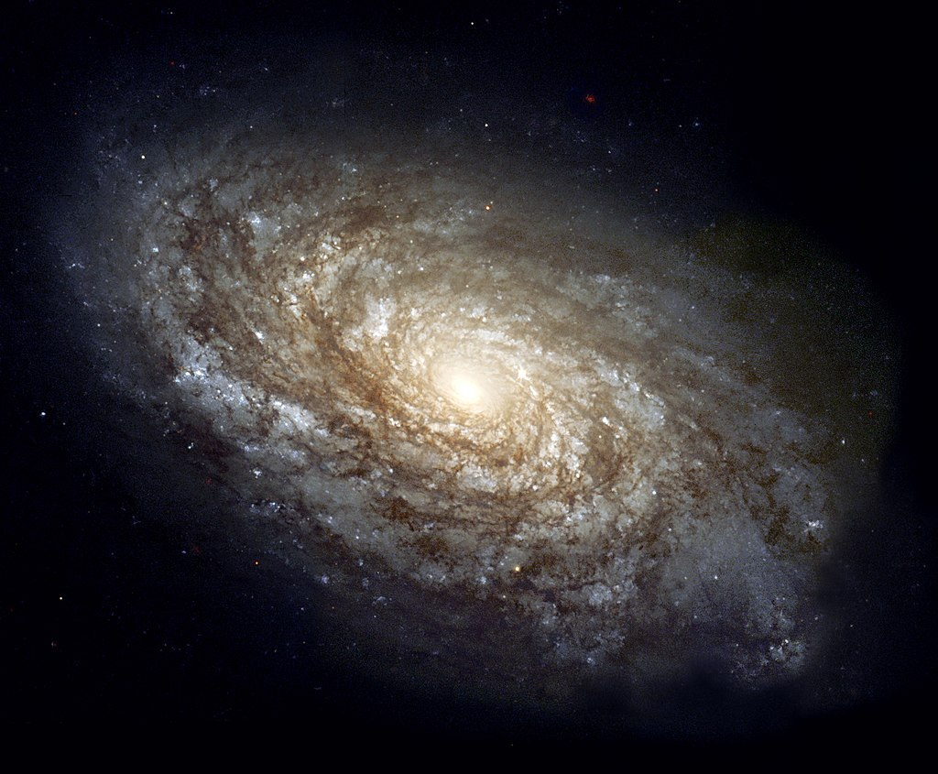
Background
Galaxy evolution is determined by physical processes such as gas accretion, star formation, and gas outflows
Chemical abundances (“metallicity”) produced by stars is a record of cumulative star formation -> stellar mass
Gas accretion and outflows directly impact metallicity, so a stellar mass-metallicity (M-Z) relation is imperative for understanding galaxy evolution models

Slide 3
Background
Past studies have assumed that high-redshift galaxies (z > 1) are similar to local galaxies (z ~ 0)
However, recent high-redshift galaxy studies have shown critical differences in galaxy gas properties, which in turn directly impact metallicity estimates
More robust metallicity measurements are needed to study the evolution of high-redshift galaxies

Slide 4
Objectives
The goal of this project is to construct a stellar mass-metallicity relation for high-redshift galaxies by using temperature-based estimates. This is often called the “direct” method
(Aller 1984; Osterbrock 1989)

Slide 5
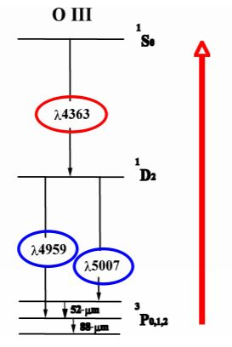
[OIII] λ4363 Emission Line
[OIII] λ4363 is an emission line that measures the kinetic temperature or the electron temperature of the gas
Heavy elements (e.g., oxygen) allow the gas to cool by emitting photons from excited energy states
Electron temperature is inversely correlated to gas metallicity
To detect this weak emission line, we stack hundreds to a thousand spectra
Source: http://zuserver2.star.ucl.ac.uk/~pmw/courses/phas2525/S03notes.pdf

Slide 6
Data: DEEP2 Galaxy Survey
High-redshift (z ~ 1-1.4), optical spectroscopic survey completed on the Keck telescope (Newman et al. 2013)
Our dataset is 4087 galaxies at z ~ 0.8 with stellar masses of ~10⁷-10¹⁰ M_{Sun}
We determined stellar masses by reconstructing the total light from billions of stars using photometric images taken at different wavelengths

Slide 7
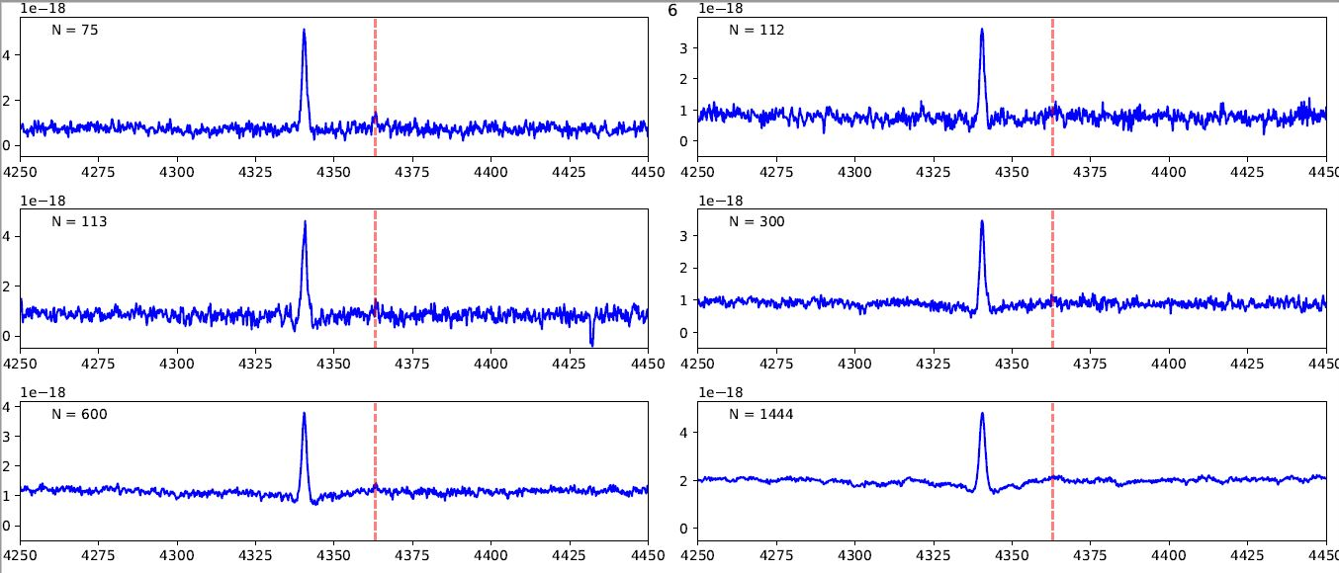
Stacked Spectra for Different Stellar Masses
We used a binning technique to group galaxies based on their stellar mass. The number of spectra in each “bin” depends on how easy it is to detect [OIII] λ4363.
Arrows indicate increasing mass
Red vertical line indicates the position of [OIII] λ4363 in the spectrum

Slide 8
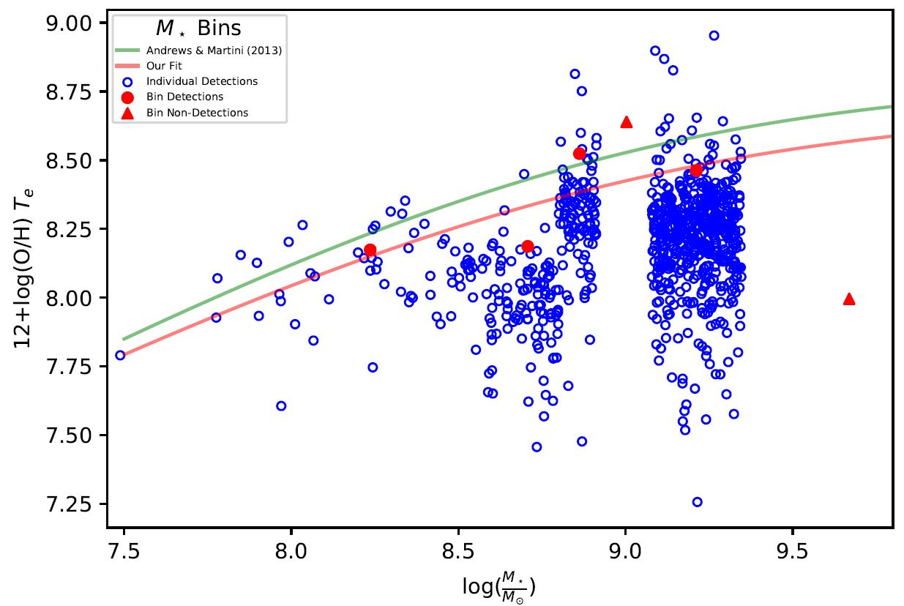
Key Results
Our M-Z relation is ~0.1 dex lower in metallicity than the relation for local galaxies (Andrews & Martini 2013)
Local relation
Our relation

Slide 9
Next Steps
We are investigating galaxy evolution further by connecting our stellar mass-metallicity relation to star formation rates
We are implementing binning that groups galaxies based on stellar mass and Hꞵ λ4861 luminosity (a star formation rate estimate)
We will derive temperature-based metallicities for these stellar mass-Hꞵ luminosity bins

Slide 10
Acknowledgements
I thank my Space Grant mentor, Dr. Chun Ly, for his support and guidance throughout this project.
I thank the Arizona/NASA Space Grant Consortium for this incredible opportunity!

Slide 11
Thank you!

Slide 12
High-redshift galaxies display different properties than local galaxies—new measurements are needed to study their evolution
My project constructed a stellar mass-metallicity relation for high-redshift galaxies
We stacked spectra in bins based on stellar mass to detect [OIII] λ4363, a metallicity indicator
We determined gas temperature, which is inversely related to metallicity
We compared our results to local galaxy surveys and find ~0.1 dex lower metallicity in the mass-metallicity relation
Additional analysis is underway to extend our mass-metallicity relation to include star formation rates

Slide 13
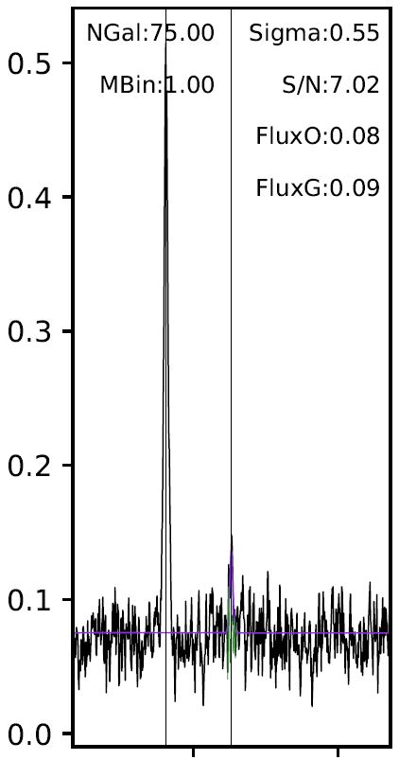
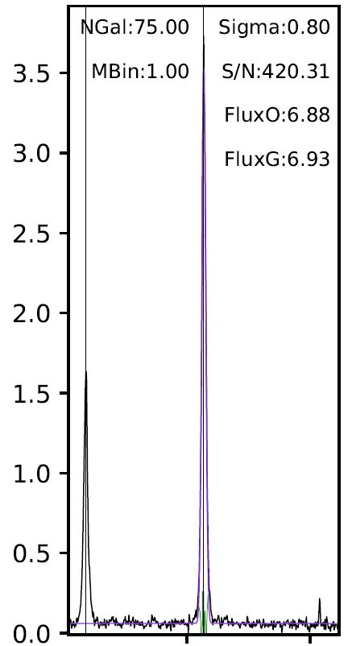
Emission Line Fits
We fit emission lines with a Gaussian profile to measure the flux and signal to noise of [OIII] λ4363 (left) and [OIII] λ5007 (right).
The ratio of [OIII] λ4363 and [OIII] λ5007 fluxes determines the electron temperature of the gas.
Flux (10⁻¹⁷ erg s⁻¹ cm⁻² Å⁻¹)
4350 4400
5000 5050
Wavelength (Å)

Slide 14
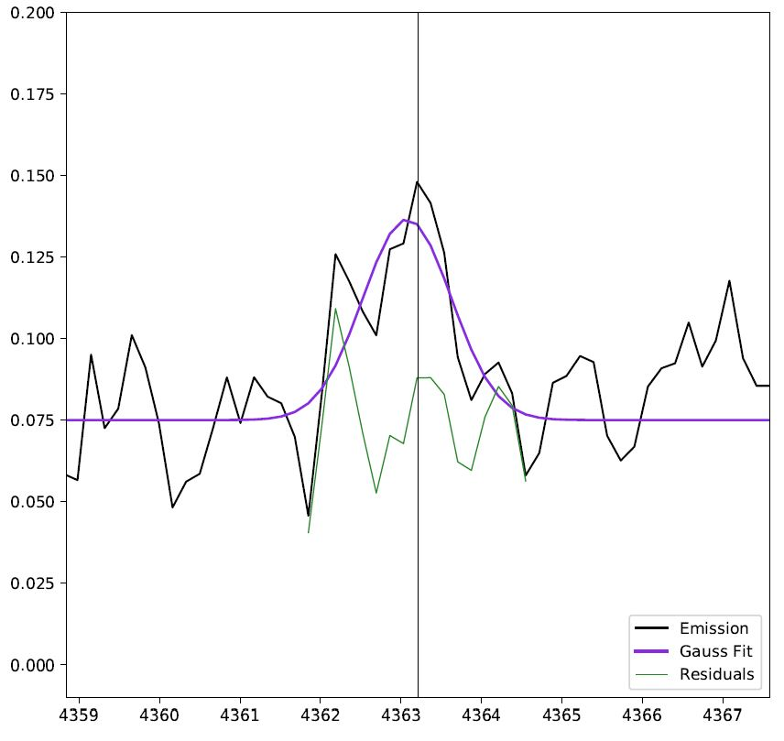
Emission Line Fits
Flux (10⁻¹⁷ erg s⁻¹ cm⁻² Å⁻¹)
4350 4400
5000 5050
Wavelength (Å)

Slide 15
Temperature Equations
Excitation Flux Ratio of [OIII] λ4363 to [OIII] λ5007:
$R= \frac{\text{[}\text{OIII}\text{] }\text{λ}\text{4363}}{\text{[}\text{OIII}\text{] }\text{λ}\text{5007} × (1+ \frac{1}{3.1})}$
The ratio of fluxes for [OIII] λ4363 and [OIII] λ5007 tells us the electron temperature in the gas.
Electron Temperature:
$$T_{e}=a×{(−\log\left(R\right)−b)}^{−c}$$
a = 13205
b = 0.92506
c = 0.98062
Ly et al. 2016

Slide 16
Metallicity Equations
$t_{2}≡\frac{T_{e}(OII)}{{10}^{4}K}$ $t_{3}≡\frac{T_{e}\left(OIII\right)}{{10}^{4}K}$ $x≡S/N(\left[OIII\right]λ4363)$
O⁺ Abundance:
$$12+\log\left(\frac{O^{+}}{H^{+}}\right)=\log\left(\frac{OII}{Hꞵ}\right)+5.961+\frac{1.676}{t_{2}}−0.4\log\left(t_{2}\right)−0.034t_{2}+log⁡(1+1.35x)$$
O⁺⁺ Abundance:
$$12+\log\left(\frac{O^{++}}{H^{+}}\right)=\log\left(\frac{OIII}{Hꞵ}\right)+6.200+\frac{1.251}{t_{3}}−0.55\log\left(t_{3}\right)−0.014t_{3}$$
Total Oxygen Abundance:
$$\frac{O}{H}=\frac{O^{+}}{H^{+}}+\frac{O^{++}}{H^{+}}$$
Ly et al. 2016

Slide 17
$$12+\log\left(\frac{O}{H}\right)=12+log⁡{(\frac{O}{H})}_{asm} −\log\left(1+{\left(\frac{M_{TO}}{M_{∗}}\right)}^{γ}\right)$$
Andrews & Martini (2013)

